Slide 1
Employee Data analysis using Excel
Student Name : Selvarani.S
Register No: 312209141
Department: B.com A&f
College: Anna Adarsh College for women

Slide 2
Project title
Employee performance analysis using Excel

Slide 3
Agenda
project overview
End users
Our solution and preposition
Dataset description
Modeling approach
Result and Discussion
Conclusion
Problem statement

Slide 4

Problem statement
In an organization often face challenges in evaluating employee performance due to 1. Inconsistent Methods 2.Data Overload 3.Time consuming process 4.Leading to inefficient and 5.Inaccurate assessments This project aims to address these issues by utilizing Excel for streamlined and effective performance analysis,

Slide 5

Problem overview
This project leverages. Excel to streamline the analysis of employee performance. It involves collecting, processing, and analyzing performance data, followed by visualizing key Insights through charts and dashboard to support informed decision-making

Slide 6

Who are the end users?
The End user of the Employee performance analysis are followed 1. HR Managers 2. Team Leaders or Supervisors 3. Senior Management 4. Employees etc.

Slide 7

Our solution and its value proposition
Conditional Formatting – Fill the blank cell using conditional formatting Filter – eliminating the blank cell Formula – using (IFS Formula) convert employee rating into performance level by grading Pivot table – preparing pivot table to identify who works more efficient in an unit wise Charts – preparing visualization of pivot table into an chart

Slide 8
DATASET DESCRIPTION
The data which I used for this analysis which I download from kaggle
There are 26 feature in the data I used 10 from the data, there are Employee id First Name Last name End date Business unit Employee type Employee classification type Gender code Current employee rating Employee performance (which were create based on current employee rating)

Slide 9

The “wow” in our solution
There are two wow factor in this analysis, there are Using IFS Formula to create performance analysis column By using slicer we can identify which classification worker has highest rating

Slide 10
Modelling
1.Dara collection Go to Kaggle website Select data base Enter employee data set and download 2. Feature collection Select the needed data for the analysis Fill those data 3. Data cleaning select the end date column By using conditional formatting fill the empty cells in the column Click the filter option for the specific column Select the sort by filter Select the blank cell 4. Performance level Select the employee rating column Create an another column name as performance level By using IFS Formula grade the employee rating into “VERY HIGH”,”HIGH”,”MED “and “LOW”

Slide 11
5.Pivot table Select the entire data Click the insert option Select the pivot table( in a new page) Select the field for the table Row – business unit column – performance level Filters – gender code values – first name Finish the pivot table 6. Visualization select the pivot table Click insert option click the recommended chart Chart will be visualise Make some adjustment (name for the chart, give axis name etc.)

Slide 12
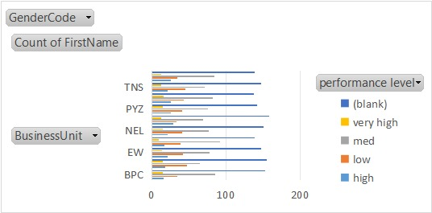
Results

Slide 13
Conclusion
This project demonstrates the power of Excel as a tool for efficient employee performance analysis. By leveraging data-driven insights, organizations can improve decision-making processes, enhance productivity, and foster employee development. The use of Excel allows for a practical and accessible approach to performance management, ensuring that evaluations are consistent, accurate, and aligned with organizational goals

